Slide 1
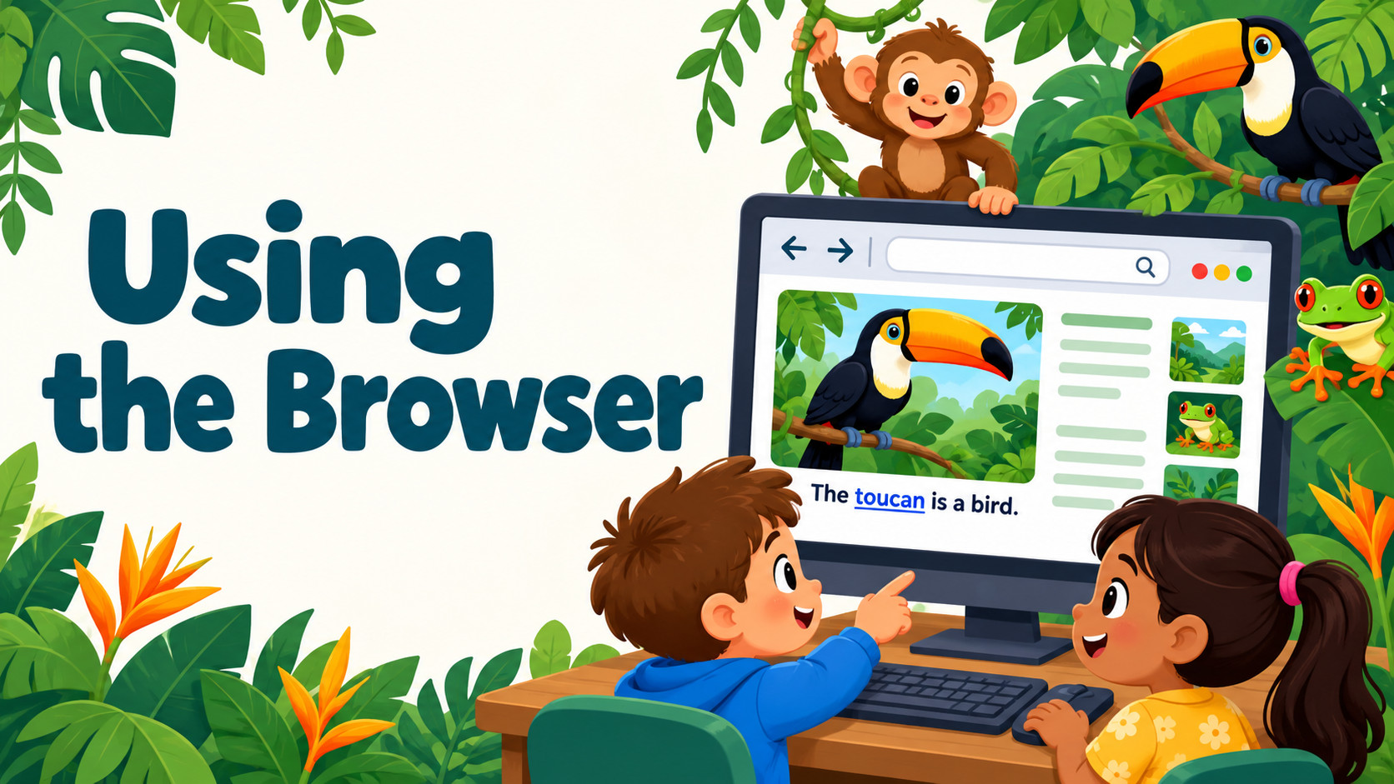
Notes:
Source: Oxford International Primary Computing Student Book 1, Unit 2 Digital literacy: Rainforests, section 2.3 Find some facts, printed pages 26–27, and section 2.4 Using the browser, pages 28–29. Classroom adaptation. Browser examples and rainforest illustrations generated for teaching. Adult support retained for finding and reading web pages.

Slide 2
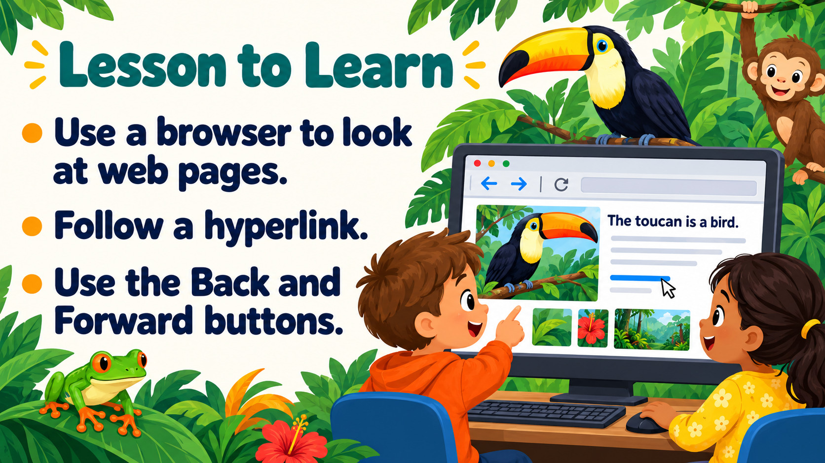
Notes:
Source: Oxford International Primary Computing Student Book 1, Unit 2 Digital literacy: Rainforests, section 2.3 Find some facts, printed pages 26–27, and section 2.4 Using the browser, pages 28–29. Classroom adaptation. Browser examples and rainforest illustrations generated for teaching. Adult support retained for finding and reading web pages.

Slide 3
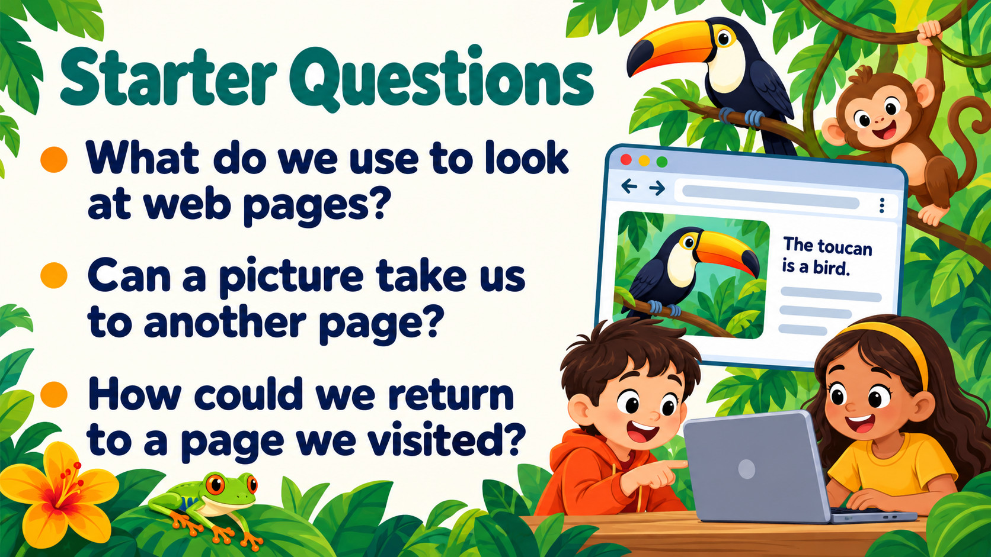
Notes:
Source: Oxford International Primary Computing Student Book 1, Unit 2 Digital literacy: Rainforests, section 2.3 Find some facts, printed pages 26–27, and section 2.4 Using the browser, pages 28–29. Classroom adaptation. Browser examples and rainforest illustrations generated for teaching. Adult support retained for finding and reading web pages.

Slide 4
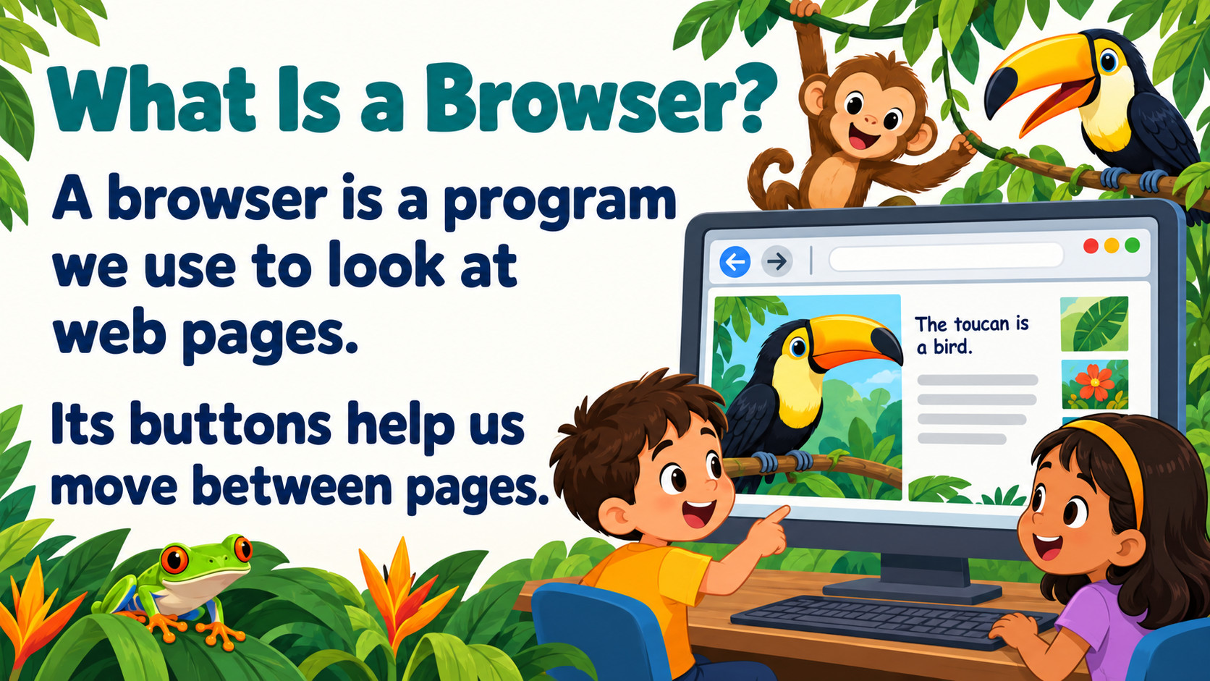
Notes:
Source: Oxford International Primary Computing Student Book 1, Unit 2 Digital literacy: Rainforests, section 2.3 Find some facts, printed pages 26–27, and section 2.4 Using the browser, pages 28–29. Classroom adaptation. Browser examples and rainforest illustrations generated for teaching. Adult support retained for finding and reading web pages.

Slide 5
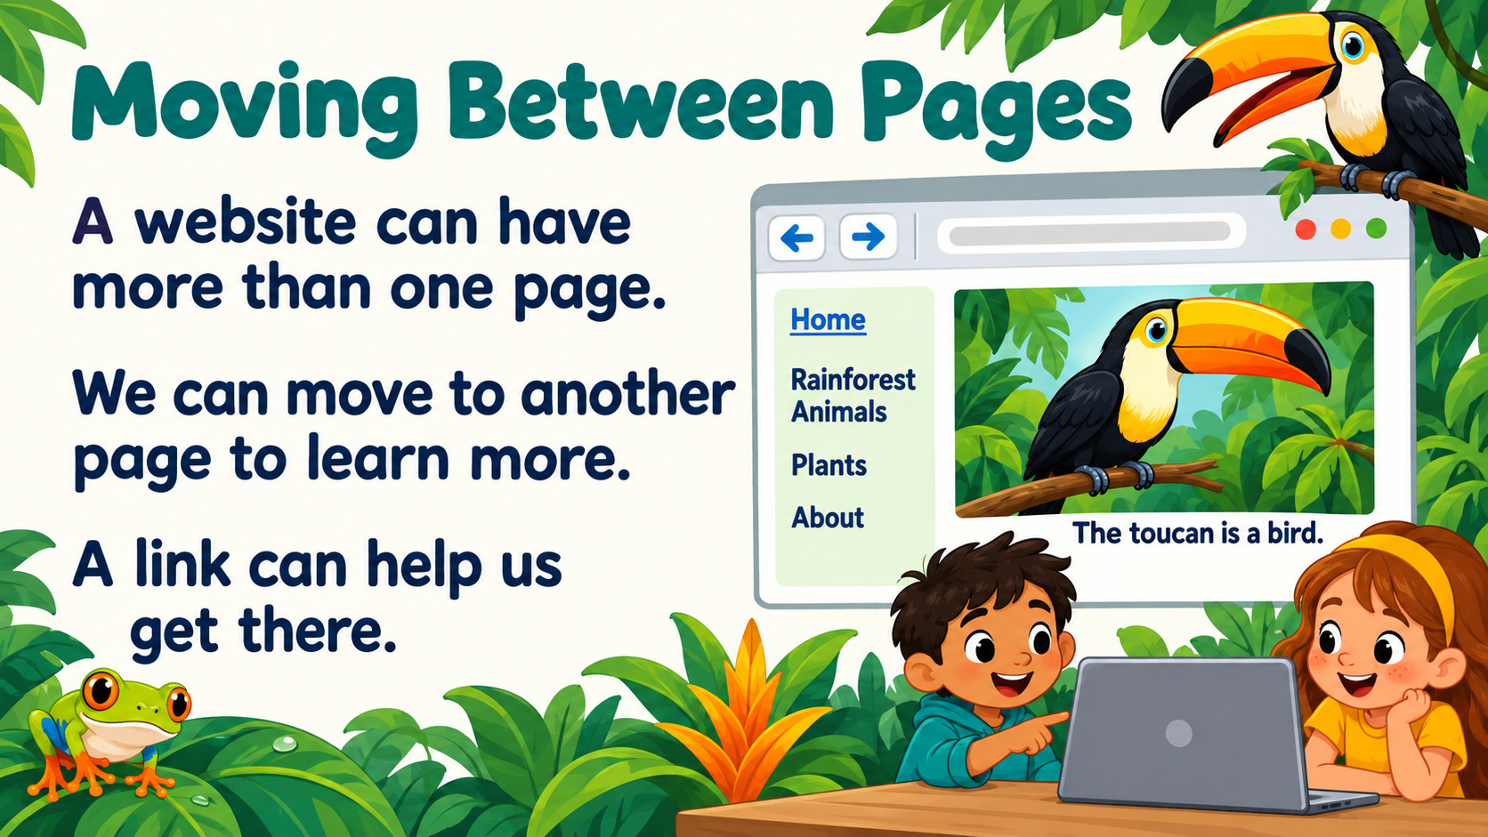
Notes:
Source: Oxford International Primary Computing Student Book 1, Unit 2 Digital literacy: Rainforests, section 2.3 Find some facts, printed pages 26–27, and section 2.4 Using the browser, pages 28–29. Classroom adaptation. Browser examples and rainforest illustrations generated for teaching. Adult support retained for finding and reading web pages.

Slide 6
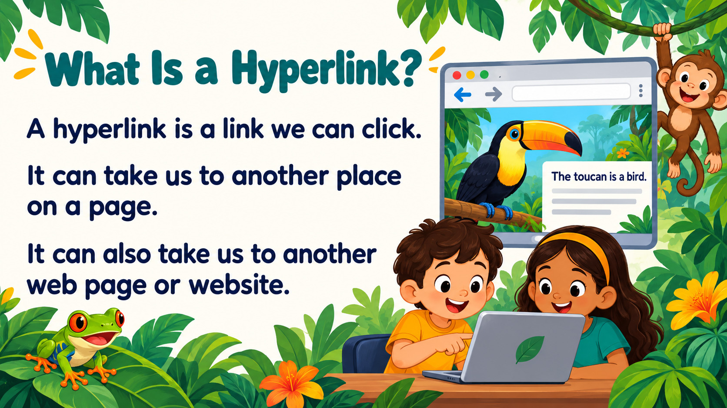
Notes:
Source: Oxford International Primary Computing Student Book 1, Unit 2 Digital literacy: Rainforests, section 2.3 Find some facts, printed pages 26–27, and section 2.4 Using the browser, pages 28–29. Classroom adaptation. Browser examples and rainforest illustrations generated for teaching. Adult support retained for finding and reading web pages.

Slide 7
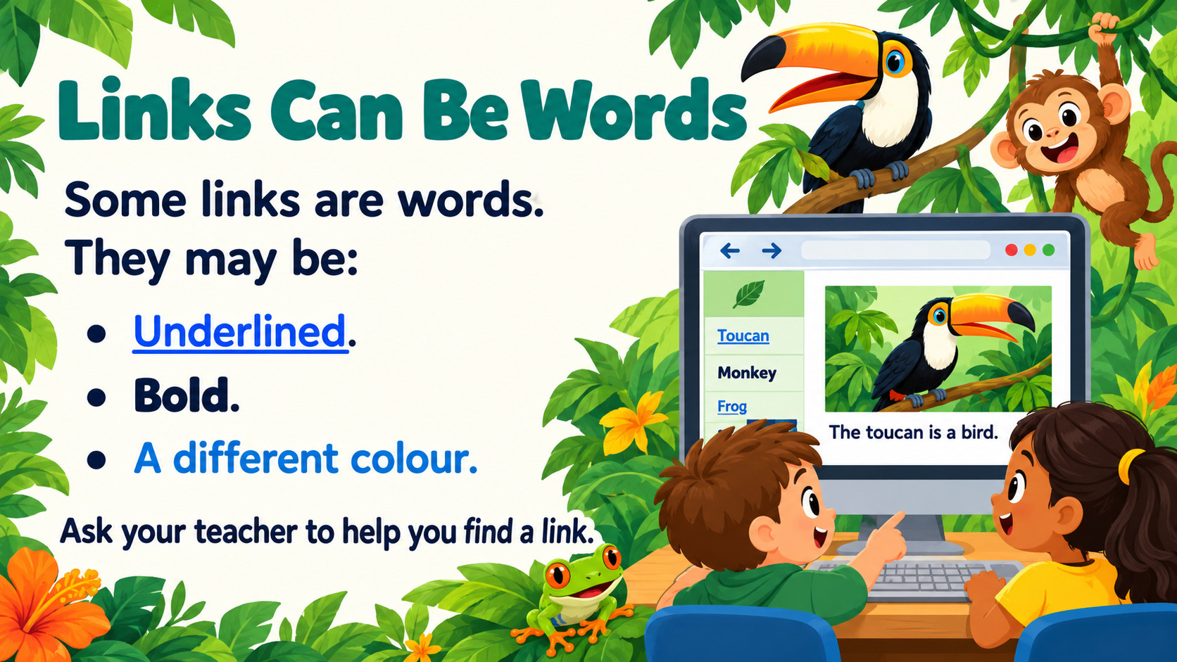
Notes:
Source: Oxford International Primary Computing Student Book 1, Unit 2 Digital literacy: Rainforests, section 2.3 Find some facts, printed pages 26–27, and section 2.4 Using the browser, pages 28–29. Classroom adaptation. Browser examples and rainforest illustrations generated for teaching. Adult support retained for finding and reading web pages.

Slide 8
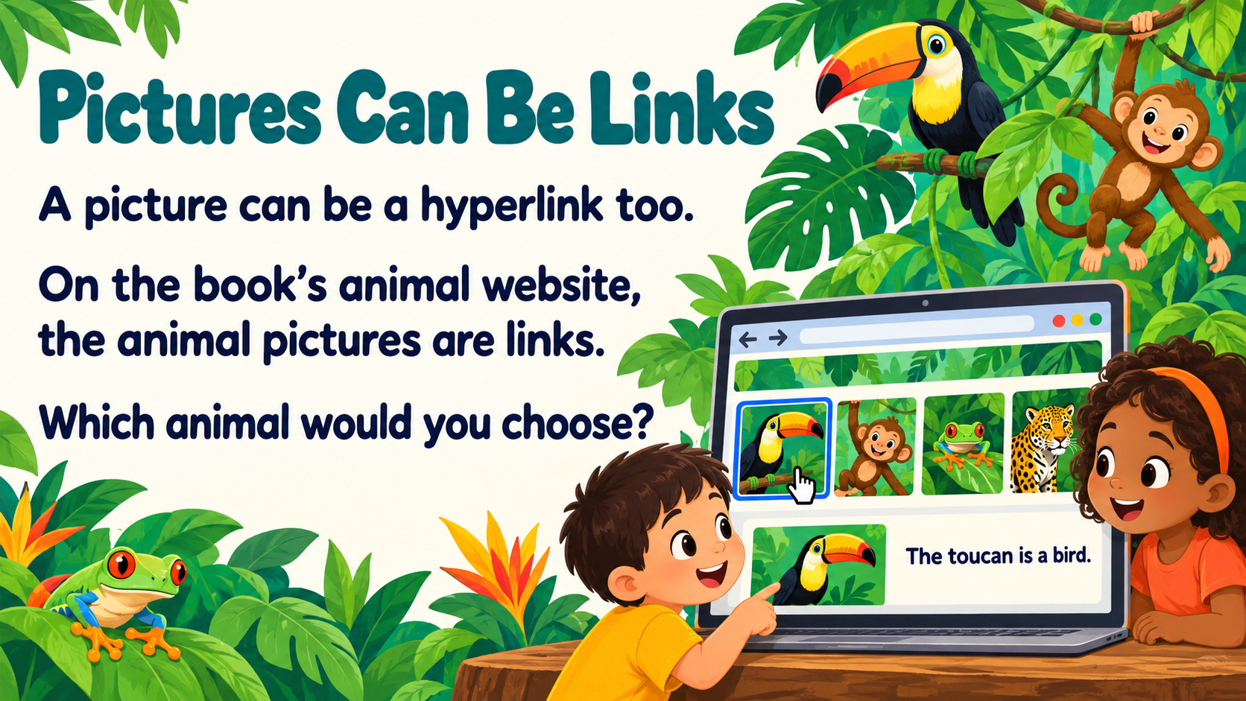
Notes:
Source: Oxford International Primary Computing Student Book 1, Unit 2 Digital literacy: Rainforests, section 2.3 Find some facts, printed pages 26–27, and section 2.4 Using the browser, pages 28–29. Classroom adaptation. Browser examples and rainforest illustrations generated for teaching. Adult support retained for finding and reading web pages.

Slide 9
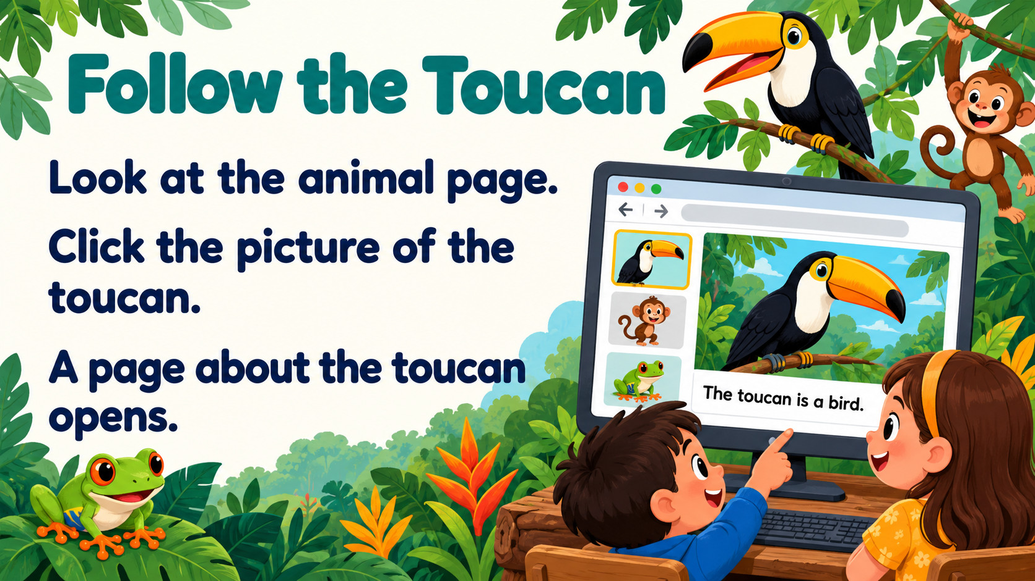
Notes:
Source: Oxford International Primary Computing Student Book 1, Unit 2 Digital literacy: Rainforests, section 2.3 Find some facts, printed pages 26–27, and section 2.4 Using the browser, pages 28–29. Classroom adaptation. Browser examples and rainforest illustrations generated for teaching. Adult support retained for finding and reading web pages.

Slide 10
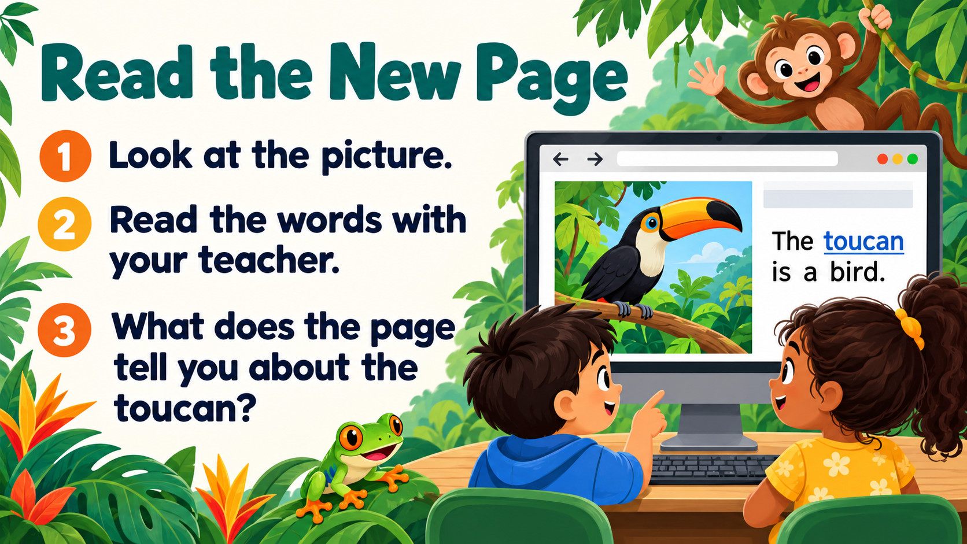
Notes:
Source: Oxford International Primary Computing Student Book 1, Unit 2 Digital literacy: Rainforests, section 2.3 Find some facts, printed pages 26–27, and section 2.4 Using the browser, pages 28–29. Classroom adaptation. Browser examples and rainforest illustrations generated for teaching. Adult support retained for finding and reading web pages.

Slide 11
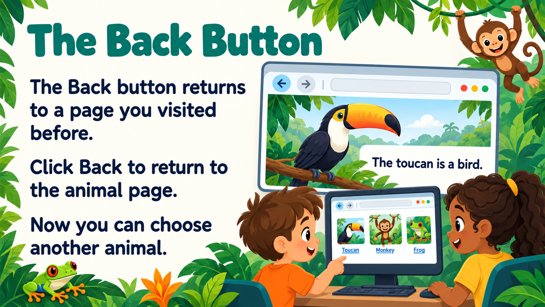
Notes:
Source: Oxford International Primary Computing Student Book 1, Unit 2 Digital literacy: Rainforests, section 2.3 Find some facts, printed pages 26–27, and section 2.4 Using the browser, pages 28–29. Classroom adaptation. Browser examples and rainforest illustrations generated for teaching. Adult support retained for finding and reading web pages.

Slide 12
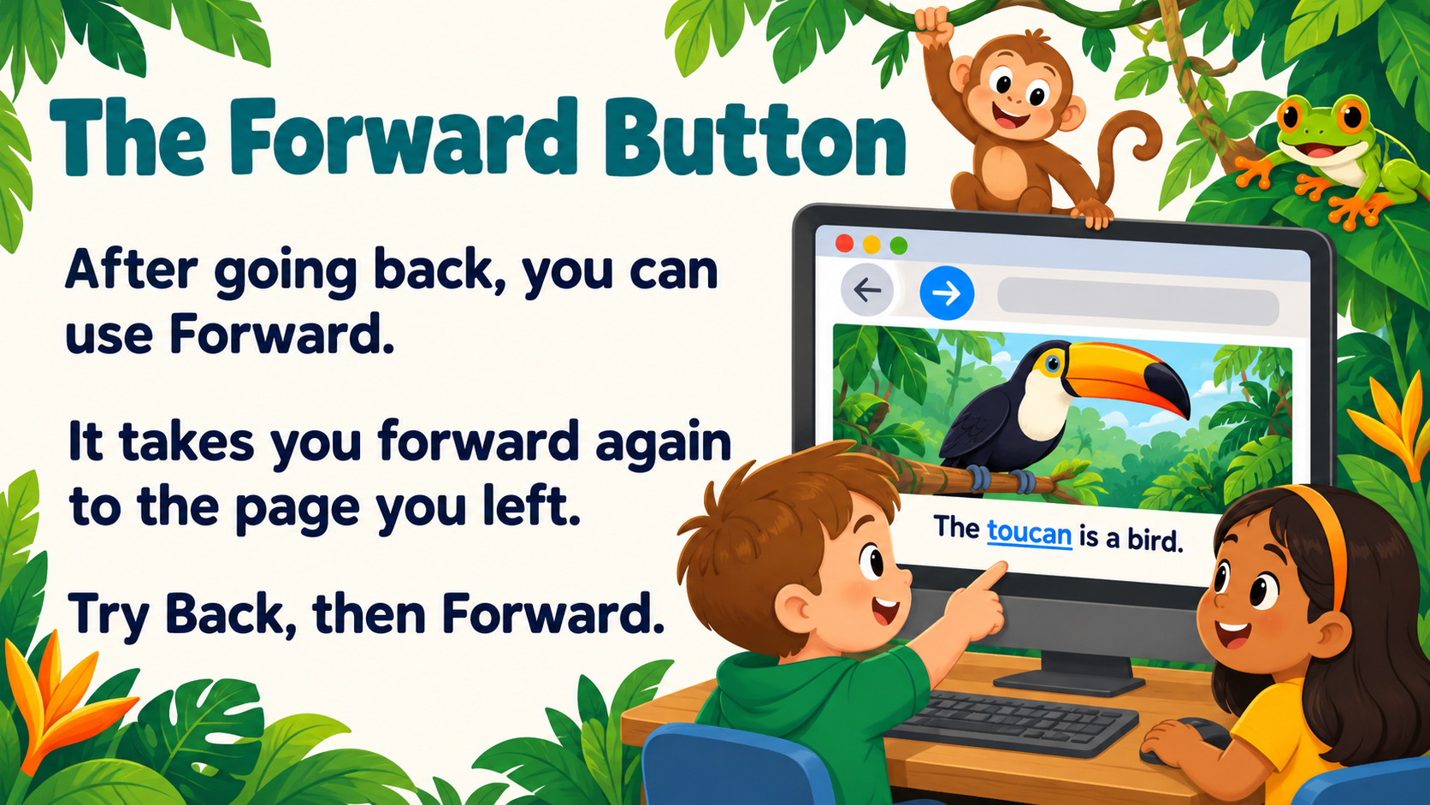
Notes:
Source: Oxford International Primary Computing Student Book 1, Unit 2 Digital literacy: Rainforests, section 2.3 Find some facts, printed pages 26–27, and section 2.4 Using the browser, pages 28–29. Classroom adaptation. Browser examples and rainforest illustrations generated for teaching. Adult support retained for finding and reading web pages.

Slide 13
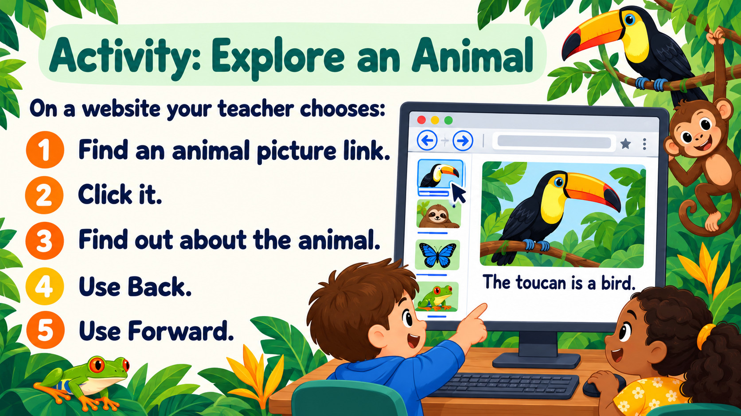
Notes:
Source: Oxford International Primary Computing Student Book 1, Unit 2 Digital literacy: Rainforests, section 2.3 Find some facts, printed pages 26–27, and section 2.4 Using the browser, pages 28–29. Classroom adaptation. Browser examples and rainforest illustrations generated for teaching. Adult support retained for finding and reading web pages.

Slide 14
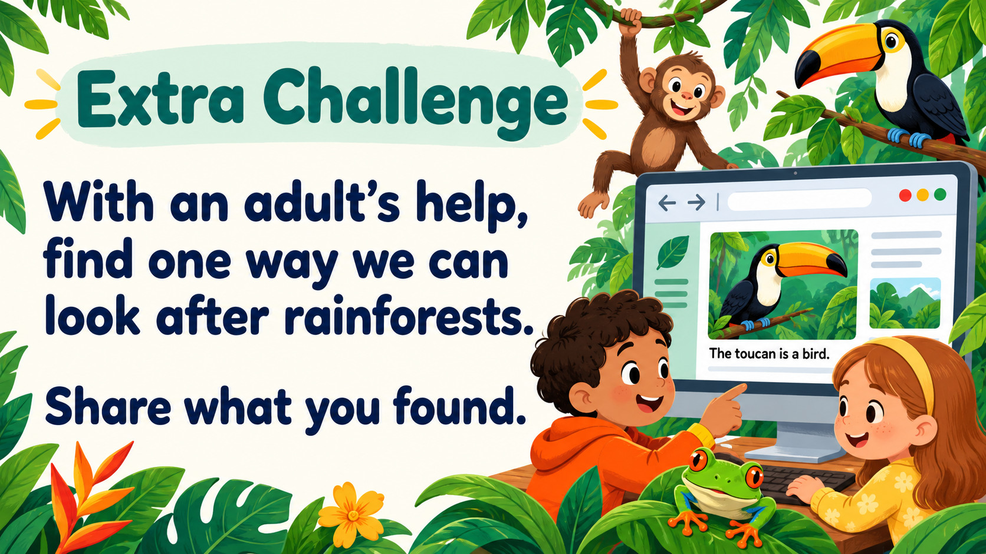
Notes:
Source: Oxford International Primary Computing Student Book 1, Unit 2 Digital literacy: Rainforests, section 2.3 Find some facts, printed pages 26–27, and section 2.4 Using the browser, pages 28–29. Classroom adaptation. Browser examples and rainforest illustrations generated for teaching. Adult support retained for finding and reading web pages.

Slide 15
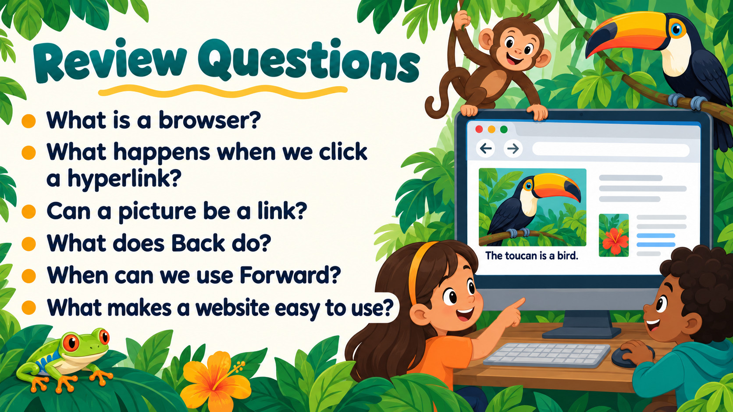
Notes:
Source: Oxford International Primary Computing Student Book 1, Unit 2 Digital literacy: Rainforests, section 2.3 Find some facts, printed pages 26–27, and section 2.4 Using the browser, pages 28–29. Classroom adaptation. Browser examples and rainforest illustrations generated for teaching. Adult support retained for finding and reading web pages.

